Slide 1

Natural Language Processing

Slide 2
NLP – Intro Session
Which classes do I have to take?
How do I register for classes/exams?
Who can help me with further questions?

Slide 3
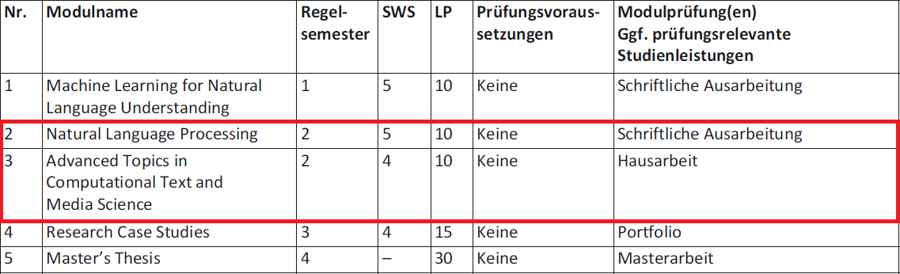
Which classes do I have to take? – Core modules

Slide 4
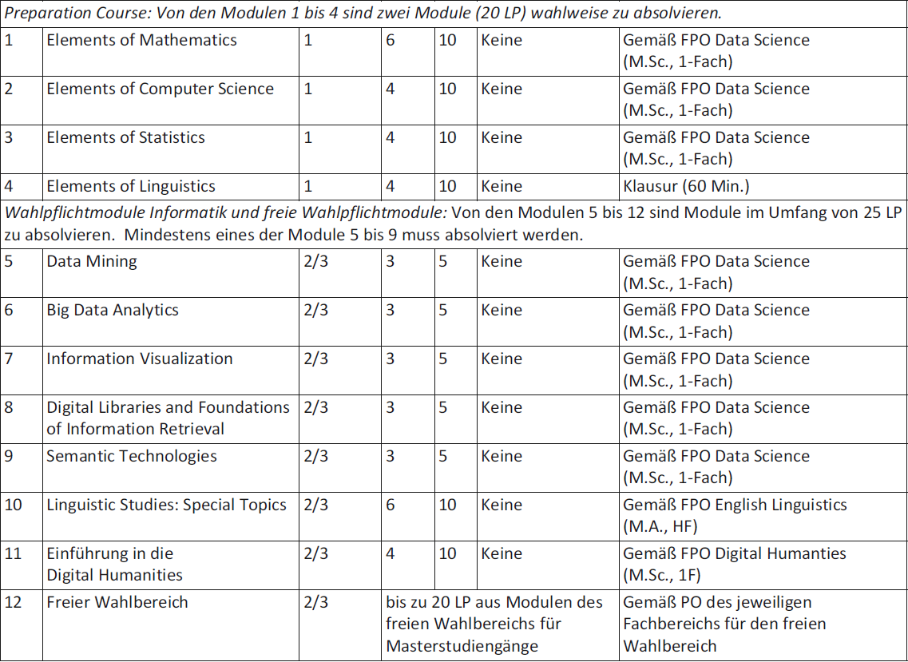
Which classes do I have to take? – Electives (Wahlpflichtmodule)

Slide 5
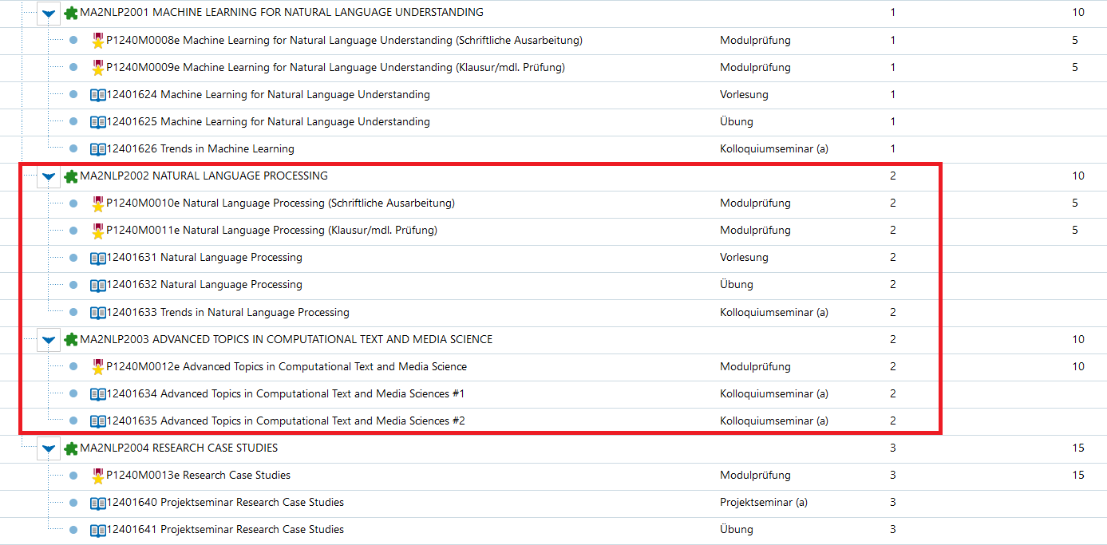
How do I register for classes/exams?

Slide 6
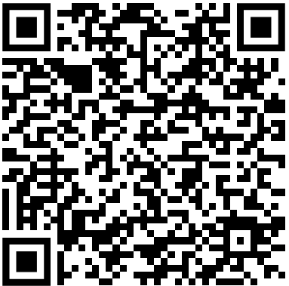
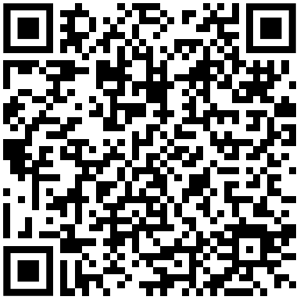
Studierendensekretariat Hochschulprüfungsamt

Slide 7
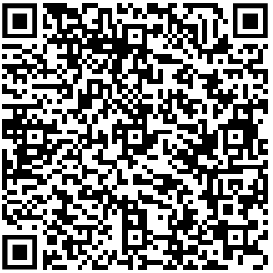
Fachprüfungsordnung (FPO)
Provides an overview over the courses you have to take, the exams and the requirements for receiving credit points
When in doubt, consult the FPO as it is the legally binding document that describes the programme

