Slide 1
Study through exchange and scholarship programs in Canada or the USA in 2024/25

Slide 2
Study through exchange and scholarship programs in Canada or the USA
Welcome!
We start at 14:05 h.
Usually, charts will be in english, lecture in german. You don‘t understand german? Please write in the chat!
This PPT is available at: https://www.uni-trier.de/international/wege-ins-ausland/studium-im-ausland/studium-usa-kanada-australien
If you have questions, you can pose them at any time. Please do this via Zoom icon , via Audio or type your question in the chat window!

Slide 3
Austauschprogramme
Austauschprogramme gehen immer in zwei Richtungen
Neben den akademischen Aspekten spielt auch der kulturelle Austausch eine wichtige Rolle
Austauschstudierende sind immer auch BotschafterInnen ihres Heimatlandes und ihrer Heimatuniversität

Slide 4
The education system in the USA
Notes:
In den USA kommen die Studierenden in der Regel alle von einer High School. Die meisten sind dann 17 oder 18 Jahre.
Undergraduate Programs = Bachelor dauern 4 Jahre: Breites Studium, man kann aus einer breiten Palette wählen (broad field of courses from different subjects)
Der reguläre Master takes only 1 year!
Professionell schools (Law schools) are only open for students with staatsexamen: Manchmal gibt es aber pre-Law-Courses, for Students ohne Staatsexamen

Slide 5
Exchange programs for studying in the USA
Target groups: Students of all subjects in Bachelor and Master
Bilaterial exchanges of Trier University for USA:
Bloomsburg University, Pennsylvania
Hamline University, St. Paul, Minnesota
Gardner-Webb University, Boiling Springs, North Carolina (*)
Francis Marion University, Florence, South Carolina (*)
Webster University, St. Louis, Missouri (*)
Saint Martin‘s University, Lacey, Washington (*)
Clark University, Worcester, Massachusetts (*)
(* ) = graduate studies possible
Multilaterial Exchanges of the ISEP program:
International Student Exchange Program* www.isep.org

Slide 6
Exchange programs for studying in Canada
Bilaterial Exchange with the University of Manitoba Students of all subjects (exception: business administration) in their Bachelor's degree; Masters possibly – depending on the subject
Tuition fee waiver; Scholarship from funds from the ERASMUS partner country program; Duration: end of August until end of April
Bilateral Exchange with the Toronto Metropolitan University (Pedagogy)
for students in the bachelor's degree in social and organizational pedagogy, in particular students with a focus on childhood, youth, family, child and youth welfare; Contact person: Dr. Annen ➔ separate call in Nov./Dez!
Multilaterial Exchanges of the ISEP program:
International Student Exchange Program* www.isep.org

Slide 7
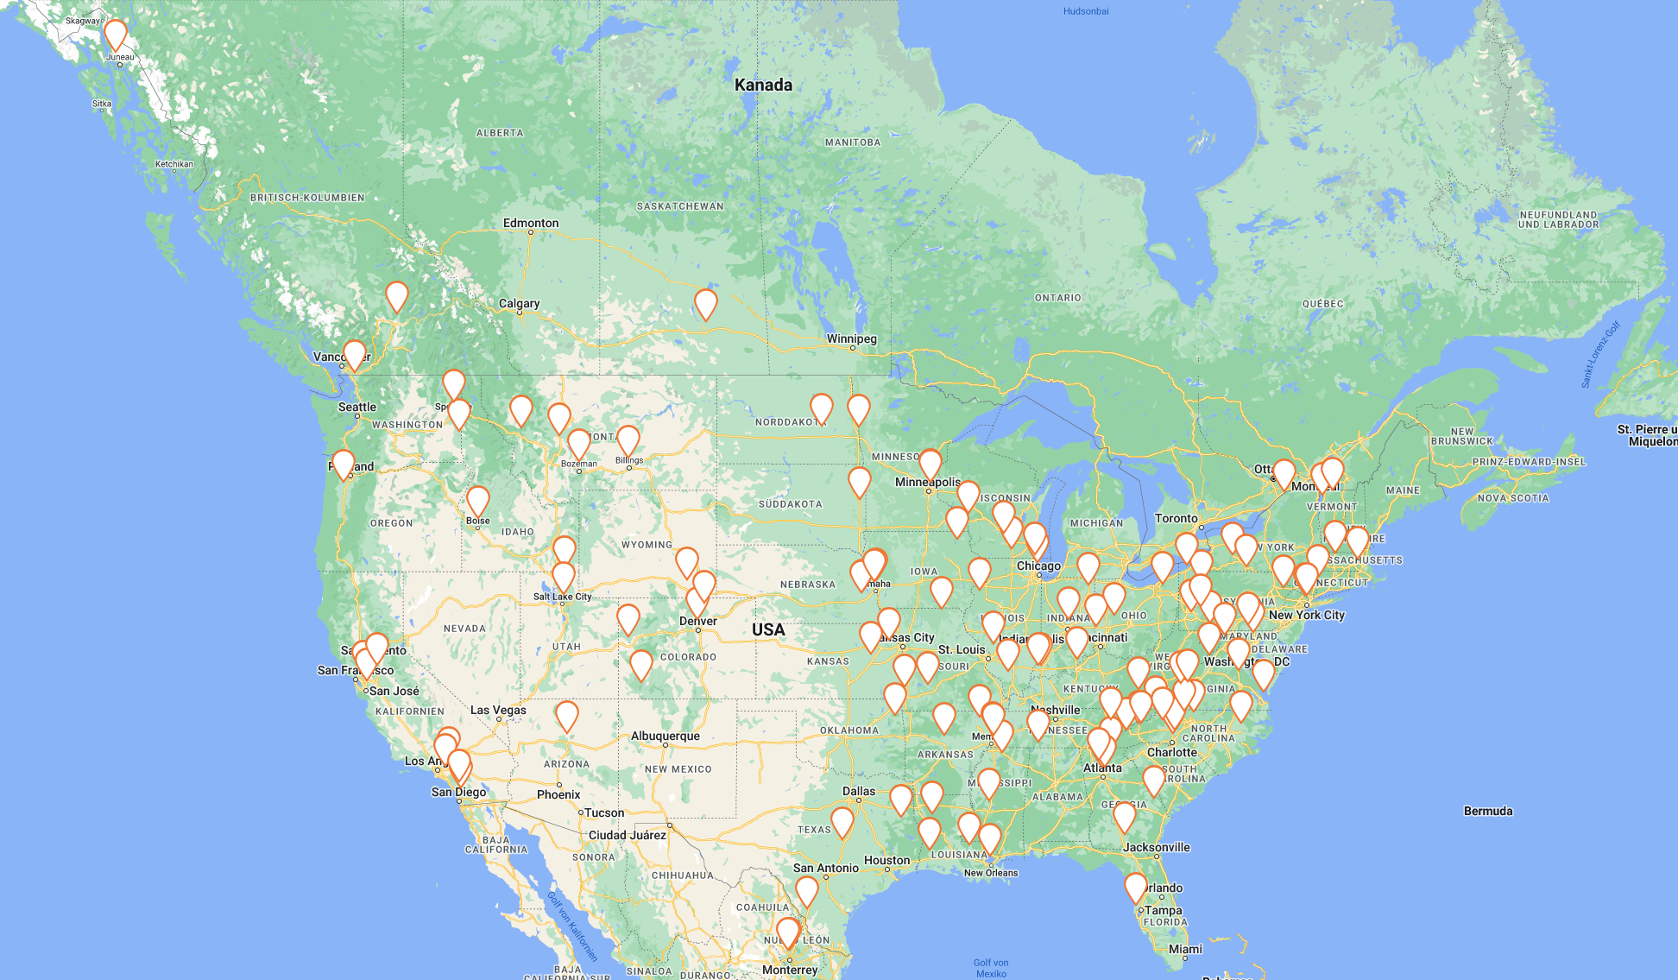
Members of ISEP in USA/Kanada:

Slide 8
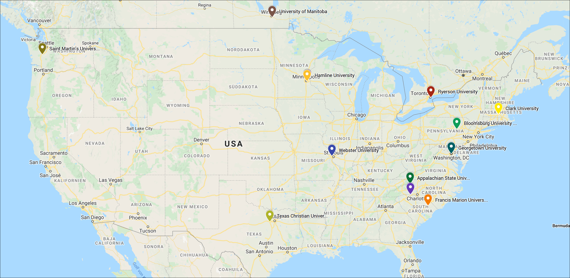
Exchange programs of Trier University:

Slide 9
Duration:
usually 2 semesters (9-10 months)
1 semester: application for one semester is also possible if the reasons are given.
Financing:
Depending on the program.
Either no tuition fees at the host university
OR
B. No tuition fees at the host university AND free accomodation and meals with contribution of 3.500 EUR: ISEP, Clark, Hamline (for one semester 2.500 Euro)
(Can be combined with BAföG and/or PROMOS-funding)
Notes:
3500 Euro für 9-10 Monate
2500 Euro für 1 Semester (3-4 Monate) (August, Sept, Okt, Nov, Dez)
Man bekommt also für 350-400 Euro pro Monat Unterkunft und Verpflegung kostenlos!!!
Man kann u.U. eine Staffelung (instalments) vereinbaren.

Slide 10
Teaching assistantships
Collaboration including teaching in the German Department of Colleges; taking usually one course per semester from the university's range of courses
Partners of Trier University for TA‘s:
Texas Christian University, Fort Worth
Gardner-Webb-University, Boiling Springs, North Carolina

Slide 11
Teaching assistantships
Target groups:
Students studying English, German as a foreign language and/or German studies in their Bachelor's or Master's degree program
Hamline und Gardner-Webb-University: completed bachelor's degree at the beginning of the stay
You should have completed the DaF basic modules by the start of the stay; Interested students without a DaF degree should be ready to acquire the basics of DaF in the semester(s) before the stay.
Duration:
one academic year (not only 1 semester!)

Slide 12
Financing/Funding for teaching assistants
exemption from tuition fees at the host university
free accommodation
meal plan
possibly monthly grant
(Can be combined with BAföG and / or PROMOS funding)

Slide 13
name | Texas Christian University
location | Fort Worth, Texas
study cycle | Bachelor and Master
study options | attendance of 1 class (3 credits)
costs | Visa costs, travel expenses, personal needs
scholarship benefits | free accomodation and board, tuition fee waver, sports, health service, transport ticket, funding: ~ 2000$ /year
job description Teaching Assistant | teaching assistance; conversations with students; German Stammtisch once a week; peer tutoring programme; organisation of events for the „German House“, field trips
accomodation | dormitory (German House)
Information is subject to change!

Slide 14
name | Gardner-Webb-University
location | Boiling Springs, North Carolina
study cycle | Master (and possibly Bachelor)
study options | 2-3 classes
costs | Visa costs, travel expenses, personal needs
scholarship benefits | Free accomodation and board (women‘s dorm), scholarship, access to rental cars
Job description Teaching Assistant | Taking over of beginner‘s classes and conversation (under guidance)
accomodation | Women‘s dormitory
Information is subject to change!
Notes:
Unterschiede:
Charakter der Uni: Konfessionelle Uni, private Uni oder öffentlich
Nur Sprachassistenz oder daneben noch Full course load (St. Thomas: Möglichkeit sein eigenes Studium voranzubringen (kostenlos!, sonst mind. 3800 Euro Eigenbeteiligung)
Tätigkeiten sind ähnlich, Unterschiede in der Stundenzahl oder ob noch im Freizeitbereich etwas geleistet werden muss (z.B. Betreuung deutsches Haus)
Leistungen sind unterschiedlich (bei manchen gibt es keine Verpflegung, bei manchnen gibt es noch ein Stipendium, was aber nicht ganz sicher ist)
Gardner-Webb: Unterbringung im Frauenwohnheim

Slide 15
Application documents for our Kanada/USA programs
Application deadline: November 19, 2023
Application documents: see www.ins-ausland-downloads.uni-trier.de (by mid of July)
Check list
Program list (only USA) (Formular)
Application form (Online and signed printout)
Certificate of enrolment
Curriculum vitae
Motivation letter
Study results (printout from PORTA)
Copy of „Abiturzeugnis“ (or similar)
2 Letters of recommentation from professors
English language Test (Trier University Language Center/Sprachenzentrum)
No language test required for students of Anglistik who have already taken language practice courses.
Toefl could be necessary later, depending from the host institution.
11. If applicable: Application form for DAAD/Promos funding

Slide 16
Application and selection procedure
Registration via “Online Application form”
Upload your documents via the Upload-Platform
Incomplete applications are sorted out!
application deadline usually mid/end of November
Review of application documents
Selection interview at the beginning of December
Acceptance/rejection letters shortly before Christmas
Nomination at the partner university in January
Application procedure at the host university (from January)
Admission documents for the host university and visa application (April-June)
Departure for the stay abroad in the middle/end of August
For the teaching assistantships, the selection interviews are conducted separately from the other programs by a smaller committee.
After you have been selected, you will be well prepared and advised by the International Office and former exchange participants for your stay abroad!

Slide 17
Further possibilities for a Stay in North America:
Academic year at the German Department of Georgetown University, USA, for students of German studies in the B.A. and M.A. (Call in Nov., application deadline Dec/Jan) https://www.uni-trier.de/index.php?id=29713#c66214
Fulbright study scholarships (only for Master’s degrees in the USA, application deadline in August!) www.fulbright.de/programs-for-germans
DAAD-Jahresstipendien Kanada/USA (application deadline in Oktober) www.auslandsstipendien.de
DAAD/PROMOS-Funding for one-semester study visits, theses, internships: www.promos.uni-trier.de
Foreign language assistants (FSA, Sprachassistenz) of the PAD (educational exchange service) (application deadline in November (USA) or January (other countries) www.kmk-pad.org/programme/fremdsprachenassistenzkraefte.html

Slide 18
Further information:
Advising on studying in USA/Kanada/Australia:
Stefanie Morgen, morgenst@uni-trier.de, Tel. 201-3398
Homepage USA/Kanada/Australia: See https://www.uni-trier.de/international/wege-ins-ausland/studium-im-ausland/studium-usa-kanada-australien
Useful links:
www.educationusa.de
https://www.daad.de/de/laenderinformationen/amerika/vereinigte-staaten-von-amerika/
https://www.daad.de/de/laenderinformationen/amerika/kanada/
www.amerikahaus.de/service/fuer-studierende/
Our programs in other countries?
See https://www.uni-trier.de/international/wege-ins-ausland
Or perhaps an internship abroad?
See https://www.uni-trier.de/international/wege-ins-ausland/praktikum-im-ausland

Slide 19
Questions?

Slide 20
Thank you very much!

Slide 21
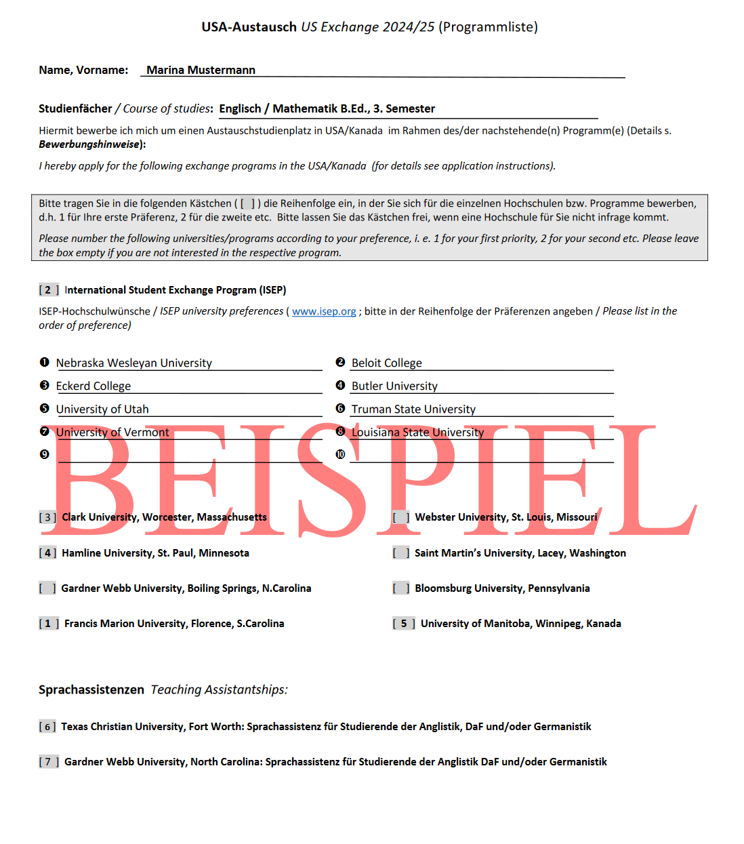
Die „Progammliste“
The „program list“

