Slide 1


Learning Agreement
Step by Step Guide for Incoming and Outgoing Students: How to Complete the Learning Agreement Part III

Slide 2
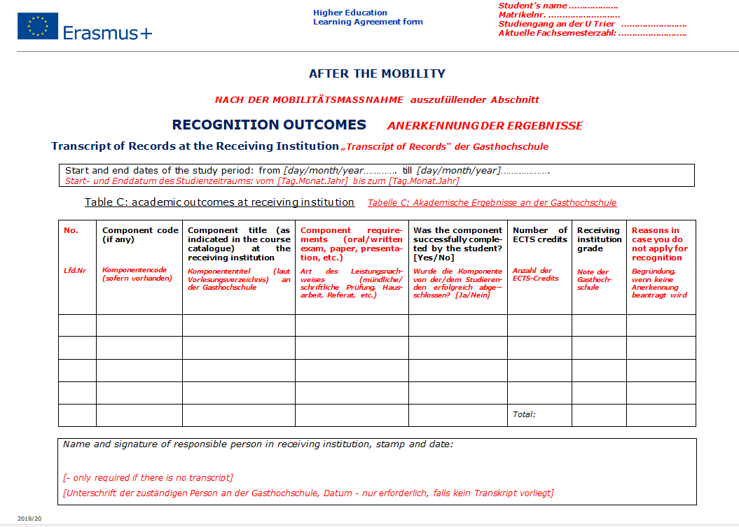
LEARNING AGREEMENT PART – AFTER YOUR MOBILITY
1.
2.
Please indicate your period of stay
3.
This part can be substituted by the Transcript(s) of Records if it includes all the classes you listed in the LA part I and II.
If the Transcript does not list all or different classes than indicated in part I and II, you need to mention these changes here and give reasons for the discrepancies.
!

Slide 3
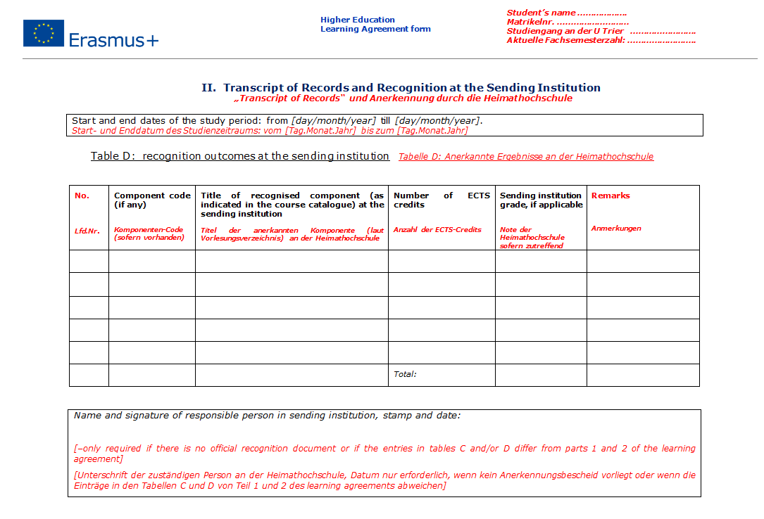
Outgoings Trier University: Table D can be substituted by the Anerkennungsbescheid.
Incomings Trier University: please complete the table
4.
Table D/ Anerkennungsbescheid needs to list all classes mentioned in LA part I and II, otherweise you need to mention these changes here and give reasons for the discrepancies.
Please submit Table C/ Transcript of Records + Anerkennungsbescheid OR Table C+D to franken@uni-trier.de
!

Slide 4
If …
…you still have questions about how to complete the Learning Agreement Part III
please contact Lea Franken, franken@uni-trier.de
…you have questions or concerns with regard to specific courses and the process of recognition
Trier University Outgoings please contact the Erasmus+ coordinator at Trier University or the Hochschulprüfungsamt
Trier University Incomings please contact the Erasmus+ coordinator at your home university

